Slide 1
Bank Loan Default Prediction
Taehoon Roh

Slide 2
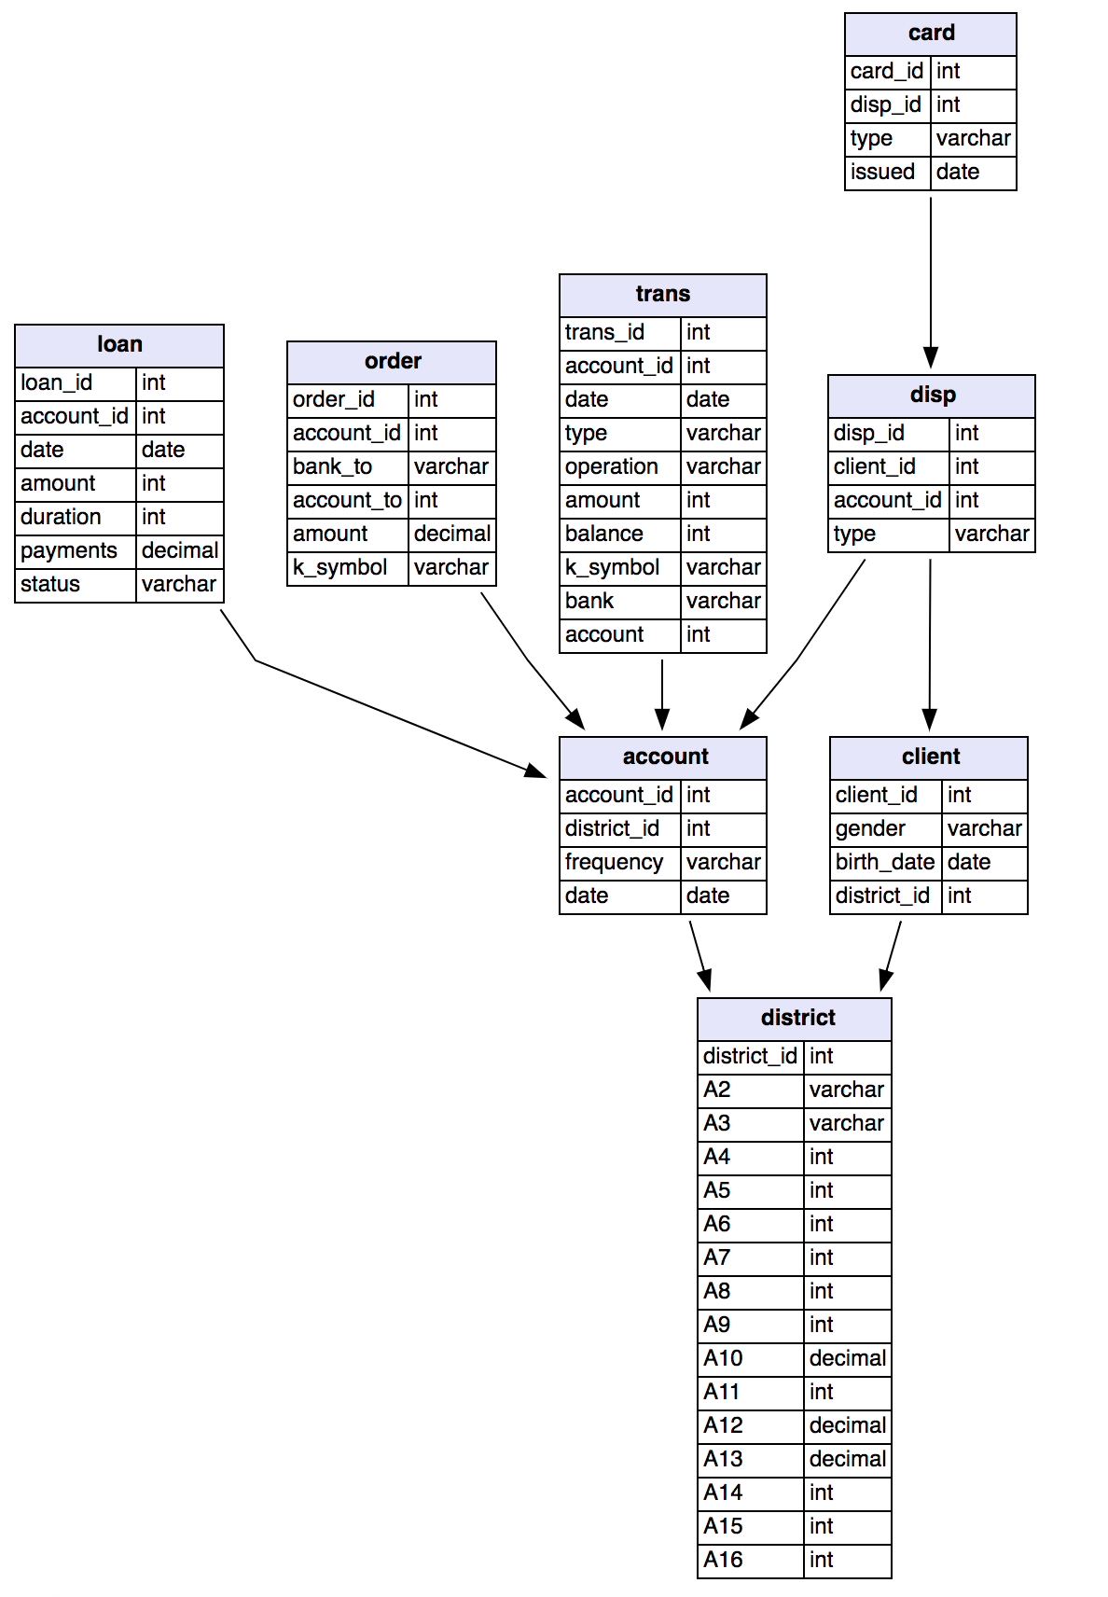
Data

Slide 3




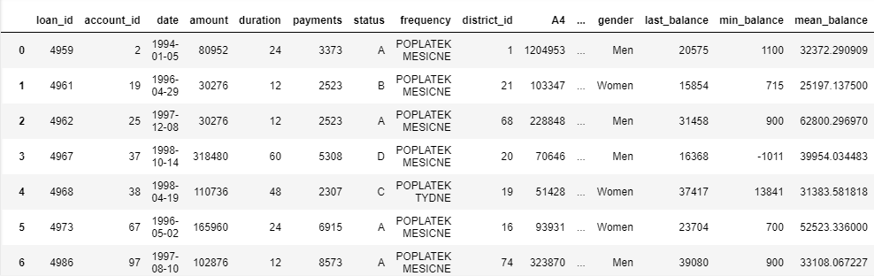
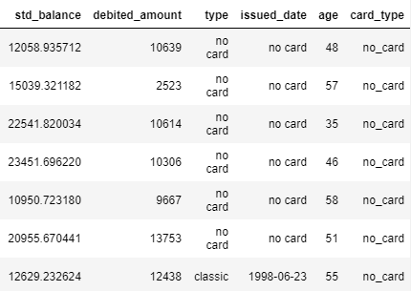
Mysql + Sqlalchemy + Pandas + Numpy
682 rows × 34 columns

Slide 4
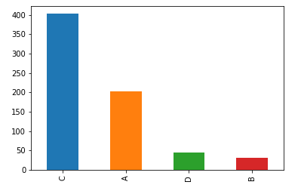
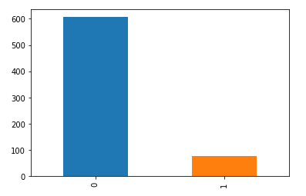
Target Variable
Status
682 loans
A : contract finished, no problems,
B : contract finished, loan not paid,
C : running contract, OK so far,
D : running contract, client in debt
0 : A + C
1 : B + D
Imbalanced -> Smote
A : 203
B : 31
C : 403 D : 45
Default
0 : 606 1 : 76

Slide 5
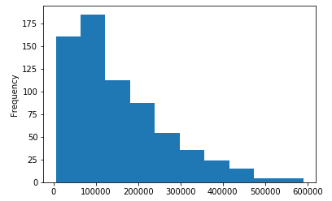
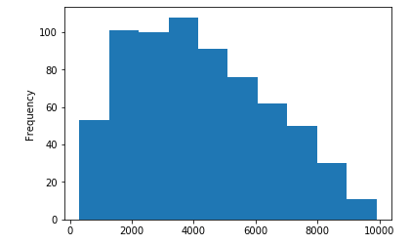
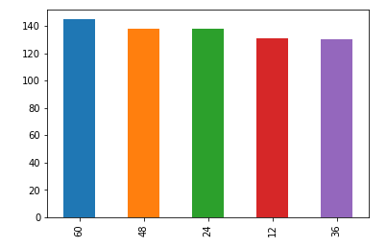
Features
Loan
Loan amount
monthly payments
duration
mean 151410.175953 std 113372.406310 min 4980.000000 25% 66732.000000 50% 116928.000000 75% 210654.000000 max 590820.000000
mean 4190.664223 std 2215.830344 min 304.000000 25% 2477.000000 50% 3934.000000 75% 5813.500000 max 9910.000000
60 : 145 48 : 138 24 : 138 12 : 131 36 : 130

Slide 6
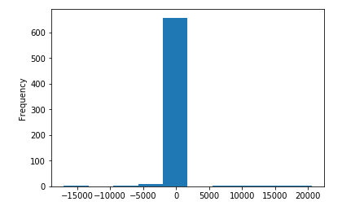
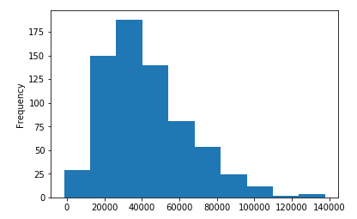
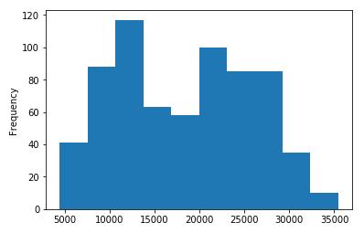
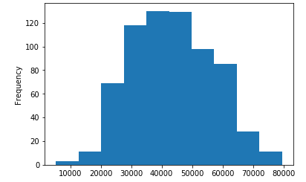
Transactions
Min balance
Last balance
mean 651.994135 std 1848.990442 min -17030.000000 25% 300.000000 50% 600.000000 75% 900.000000 max 20574.000000
mean 42383.570381 std 22516.595485 min -1572.000000 25% 25918.500000 50% 38315.500000 75% 54580.000000 max 137843.000000
Mean balance
std balance
mean 43610.168682 std 13472.373437 min 5350.000000 25% 32833.081400 50% 43207.928547 75% 53614.015301 max 79500.529762
mean 18355.398745 std 7481.459342 min 4462.706158 25% 11687.797057 50% 18893.263292 75% 24705.349918 max 35435.984338

Slide 7
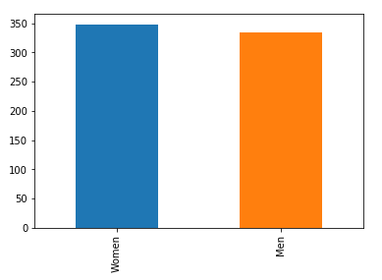
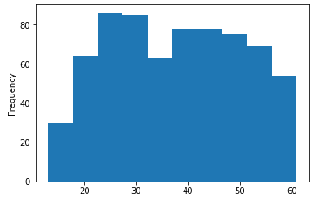
Client
Gender
Age
mean 37.630499 std 12.768289 min 13.000000 25% 27.000000 50% 37.000000 75% 48.000000 max 61.000000
Women 348 Men 334

Slide 8
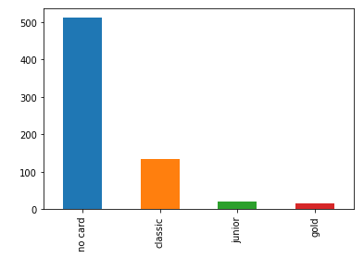
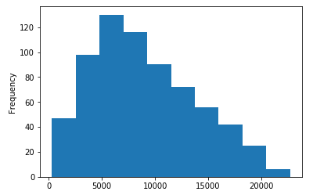
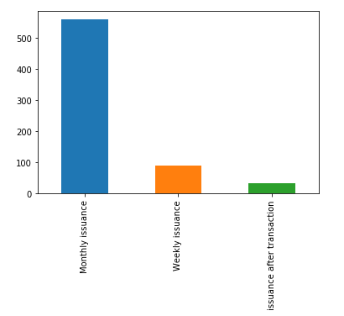
Credit Card
Orders
Account
Card type
Debited_amount
Frequency
no_card 646 classic 28 junior 5 gold 3
mean 9003.368035 std 4842.862438 min 312.000000 25% 5302.500000 50% 8047.500000 75% 12434.750000 max 22704.000000
Monthly issuance 559 Weekly issuance 91 issuance after transaction 32

Slide 9
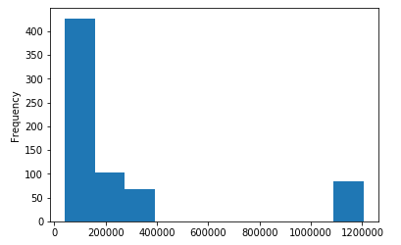
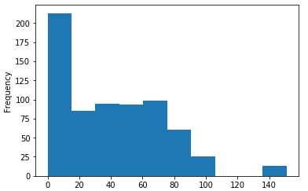
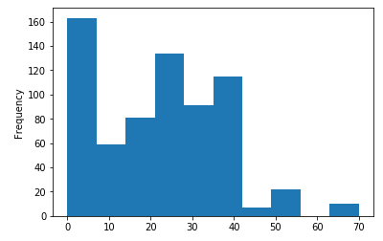
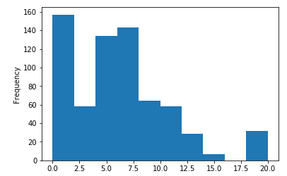
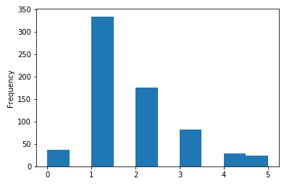
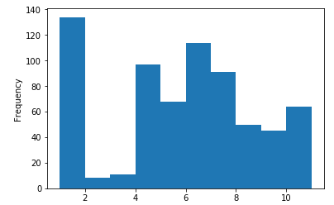
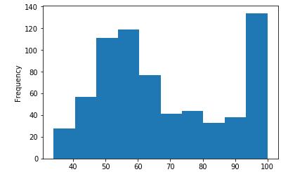
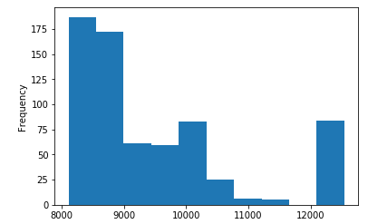
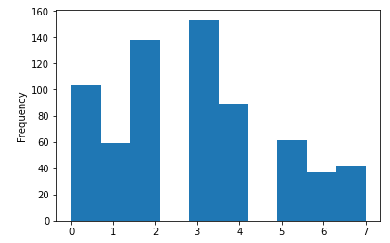
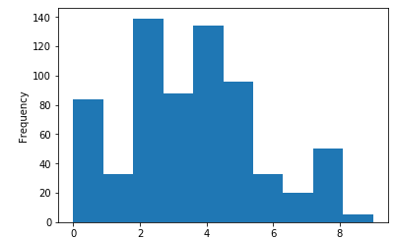
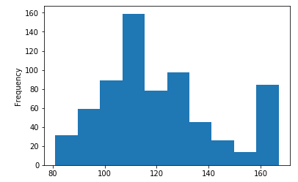
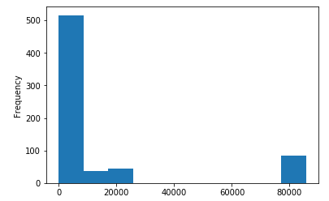
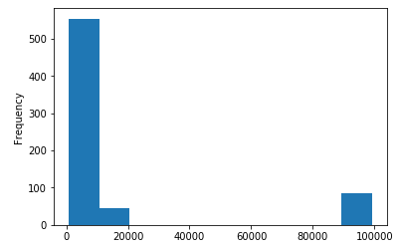
Demographic Data
A4
A5
A6
A7
A8
A9
A10
A11
A12
A13
A14
A15
A16

Slide 10
A4 : no. Of inhabitants
A5 : no. of municipalities with inhabitants < 499
A6 : no. of municipalities with inhabitants 500-1999
A7 : no. of municipalities with inhabitants 2000-9999
A8 : no. of municipalities with inhabitants >10000
A9 : no. of cities
A10 : ratio of urban inhabitants
A11 : average salary
A12 : unemployment rate '95
A13 : unemployment rate '96
A14 : no. of entrepreneurs per 1000 inhabitants
A15 : no. of commited crimes '95
A16 : no. of commited crimes '96

Slide 11
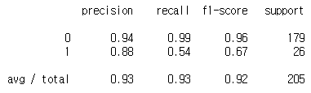
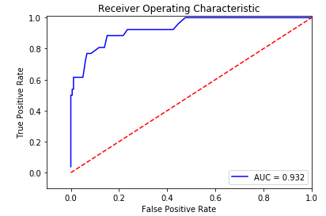
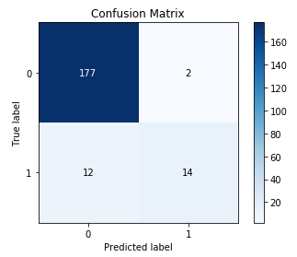
ML Model
1. RandomForest

Slide 12
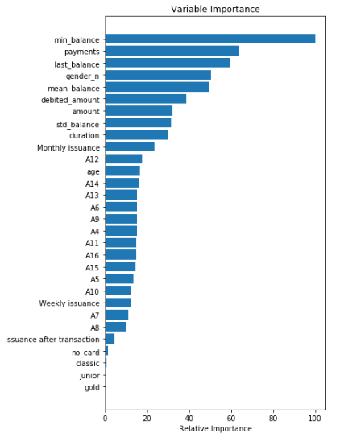
RandomForest
Variable Importance

Slide 13
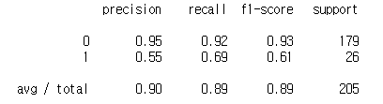
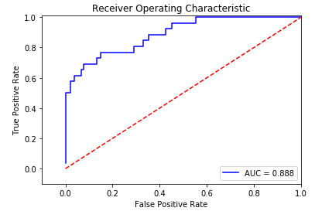
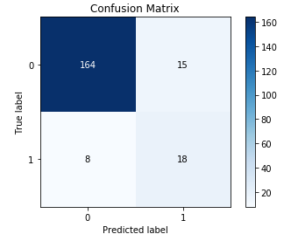
ML Model
2. AdaBoost

Slide 14
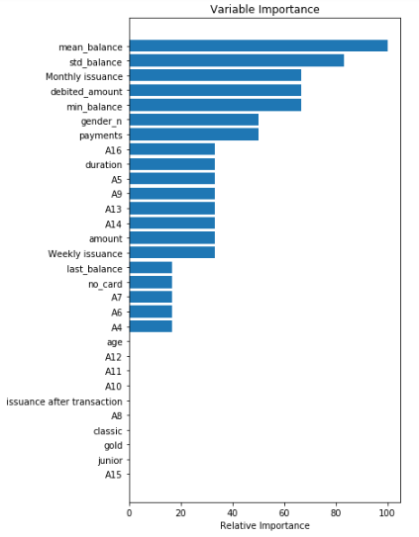
Adaboost
Variable Importance

Slide 15
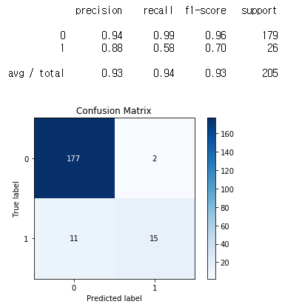
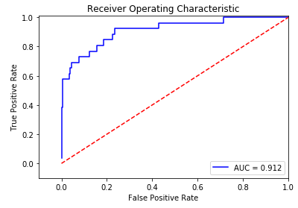
ML Model
3. Gradient Boost

Slide 16
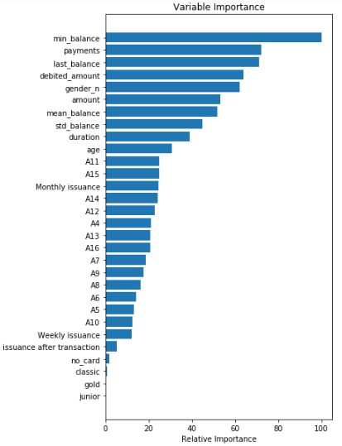
Gradient Boost
Variable Importance

Slide 17
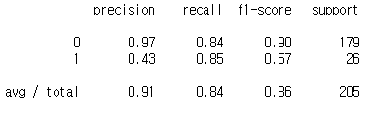
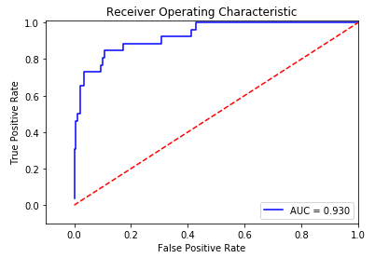
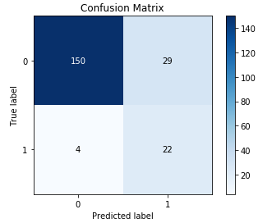
ML Model
4. Logistic Regression

Slide 18
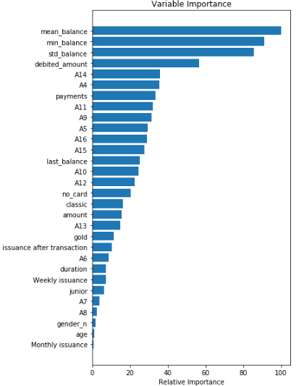
Logistic Regression
Variable Importance

Slide 19
ML Model Summary
 | Logistic Regression | Random Forest | AdaBoost | Gradient Boost
AUC | 0.93 | 0.932 | 0.888 | 0.912
Recall for default | 0.85 | 0.54 | 0.69 | 0.58
Top 5 Key Predictors | Mean balance Min balance Std balance Debited amount A14 | Min balance Payments Last balance Gender Mean balance | Mean balance Std balance Monthly Issuance Debited amount Min balance | Min balance Payment Last balance Debited amount Gender
A14 : no. of entrepreneurs per 1000 inhabitants

